Slide 1
DIFFERENT TYPE OF CABLE NETWORK

Slide 2
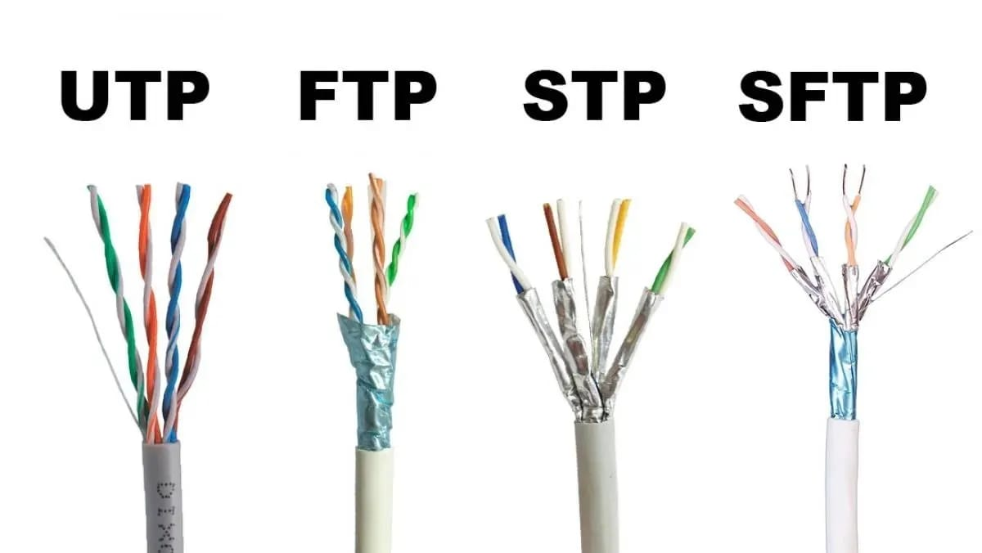
WHAT ARE THE DIFFERENT TYPES OF CABLE NETWORK ?
Basic cable networks: These are the most common type of cable networks and typically include popular channels like CNN, ESPN, and Nickelodeon.
Premium cable networks: These networks require an additional subscription fee and offer premium content such as HBO, Showtime, and Starz.
Regional cable networks: These networks focus on local or regional programming and may include channels like regional sports networks or local news channels.
Specialty cable networks: These networks cater to specific interests or demographics, such as cooking channels, home improvement channels, or music channels.
International cable networks: These networks offer programming from other countries and may include channels like BBC World News or Telemundo.
Pay-per-view networks: These networks offer special events or movies for a one-time fee.
These are just a few examples of the different types of cable networks available.

Slide 3
WHAT IS CALLED NETWORK?
A network is a group of interconnected people or organizations that work together to share information, resources, or services. In the context of television and media, a network refers to a group of television stations or channels that are owned or operated by the same company or organization. These networks typically broadcast programming to a wide audience and may include both local and national channels. Examples of television networks include ABC, NBC, CBS, and Fox in the United States.

Slide 4
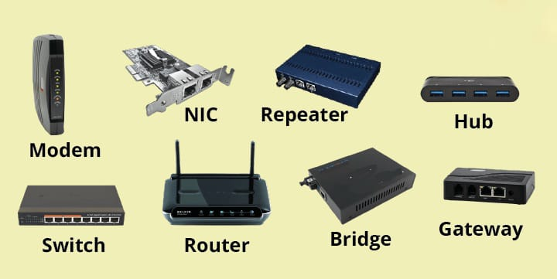
WHAT IS THE NETWORK DEVICE?
A network device is a piece of hardware that is used to connect computers, servers, printers, and other devices to a network. Network devices help facilitate communication and data exchange between different devices on a network. Some common network devices include:
1. Routers: Routers are devices that forward data packets between computer networks. They are essential for connecting multiple devices to the internet and for routing data between different networks.
2. Switches: Switches are devices that connect multiple devices within a local area network (LAN). They help direct data traffic to the appropriate destination within the network.
3. Modems: Modems are devices that modulate and demodulate analog signals to convert digital data into a form that can be transmitted over telephone lines or cable lines. They are commonly used to connect to the internet
.4. Access Points: Access points are devices that allow wireless devices to connect to a wired network using Wi-Fi. They provide wireless connectivity within a specific area or location.
5. Network Interface Cards (NICs): NICs are hardware components that allow computers to connect to a network. They are usually built into computers or can be added as expansion cards.These are just a few examples of network devices that are commonly used to establish and maintain communication within computer networks.

Slide 5
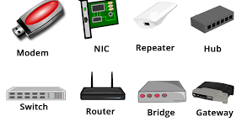
WHAT ARE THE 4 DEVICE NEEDED CONNECT TO THE INTERNET ?
1. Modem: A modem is a device that modulates and demodulates signals to convert digital data from your computer into a form that can be transmitted over telephone lines, cable lines, fiber optics, or other communication channels. The modem establishes a connection between your computer and your Internet Service Provider (ISP) to access the internet.
2. Router: A router is a networking device that forwards data packets between computer networks. In the context of connecting to the internet, a router is used to create a local area network (LAN) within your home or office and connects it to the internet through the modem. The router manages the traffic between your devices and the internet.
3. Network Interface Card (NIC): A Network Interface Card, commonly referred to as NIC or network adapter, is a hardware component that enables your computer to connect to a network. Most modern computers come with built-in NICs, but you may need an external NIC if your computer does not have one.
4. Device (Computer, Smartphone, Tablet, etc.): The final device you need to connect to the internet is the device itself, such as a computer, smartphone, tablet, smart TV, or any other device that can access the internet. This device communicates with the router to send and receive data over the network.By having these four essential devices - modem, router, NIC, and your device - properly set up and configured, you can establish a connection to the internet and start browsing, streaming, emailing, or performing any online activities.

Slide 6
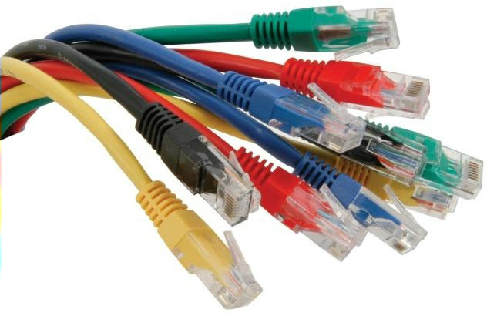
WHICH CABLE IS BEST FOR NETWORKING?
Cat 7a is the best cable for high-speed Internet—and the most expensive. Similar to the Cat 6a and Cat 7 cables, the Cat 7a supports speeds up to 10,000 Mbps, but its max bandwidth is exponentially higher at 1,000 MHz.

Slide 7
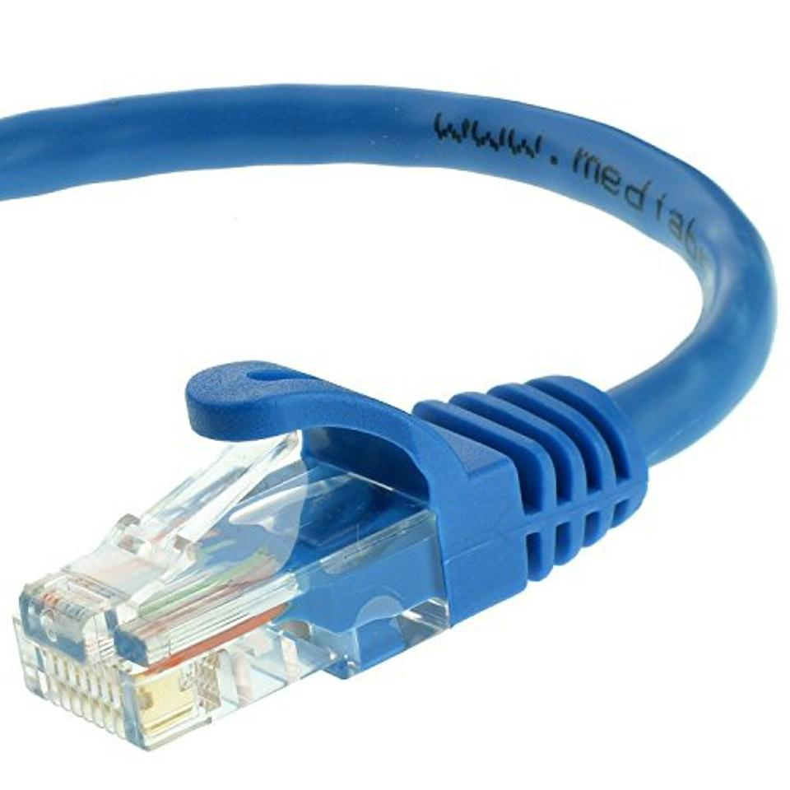
WHAT IS THE FASTEST NETWORK CABLE?
As of now, the fastest networking cable available is the Category 8 (Cat 8) Ethernet cable. Cat 8 cables are designed to support data transmission speeds of up to 40 Gbps over distances of up to 30 meters. They use a shielded twisted pair design to minimize crosstalk and electromagnetic interference, allowing for high-speed and reliable data transmission.
Cat 8 cables are commonly used in data centers, server rooms, and other high-performance networking environments where ultra-fast connectivity is required. While Cat 8 cables are currently the fastest copper Ethernet cables available, it's worth noting that fiber optic cables can support even higher speeds and longer distances, making them ideal for certain applications that demand maximum performance.

